Slide 1
HTML
History of HTML
Tags, Elements and Attributes
How to differentiate HTML Document Versions
Basic Formatting Tags
Grouping Using Div Span
Lists, Images, Table, Hyperlink, Frames
HTML Forms
Introduction to HTML5
Features of HTML5
HTML5 Tags – Audio, Video, Canvas

Slide 3
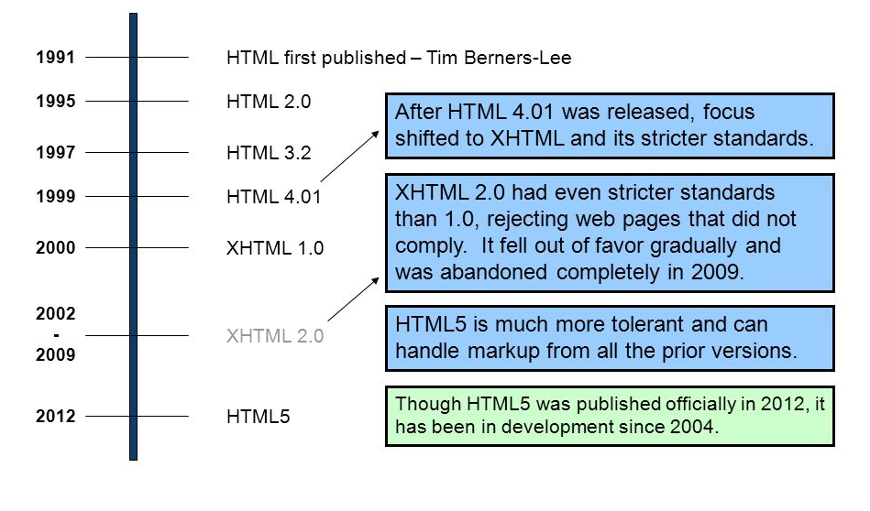
History of HTML

Slide 4
HTML basics
Hyper Text Markup Language is a simple markup language used to create platform- independent hypertext documents on the World Wide Web
An HTML document consist of its basic building blocks which are:
Tags: An HTML tag surrounds the content and apply meaning to it. It is written between < and > brackets.
Attribute: An attribute in HTML provides extra information about the element, and it is applied within the start tag. An HTML attribute contains two fields: name & value

Slide 5
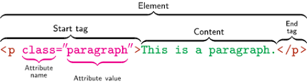
Example

Slide 6
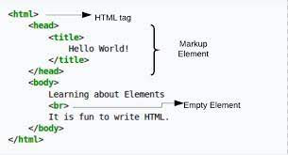
Sample HTML Code

Slide 7
Basic Formatting Tags
Tag | Description | Example
<b> | is used to bold the text written between it. | <b>Write Your Name in bold text.</b>
<strong> | which tells the browser that the text is important. | <p><strong>This is an important content</strong>, and this is normal content</p>
<i> | which is used to make text italic. | <p> <i>Write Your First Paragraph in italic text.</i></p>
<em> | which is used to display content in italic. | <p><em>This is an important content</em>, which displayed in italic font.</p>
<mark> | This tag is used to highlight text. | <h2> I want to put a <mark> Mark</mark> on your face</h2>
<u> | This tag is used to underline text written between it. | <p> <u>Write Your First Paragraph in underlined text.</u></p>

Slide 8
Basic Formatting Tags
<mark> | This tag is used to highlight text. | <h2> I want to put a <mark> Mark</mark> on your face</h2>
<u> | This tag is used to underline text written between it. | <p> <u>Write Your First Paragraph in underlined text.</u></p>
<sup> | It displays the content slightly above the normal line. | <p>X <sup>2</sup></p>
<sub> | It displays the content slightly below the normal line. | <p>X <sub>1</sub></p>

Slide 9
Basic Formatting Tags
Tag | Description | Example
<del> | Anything that puts within <del>..........</del> is displayed as deleted text. | <del> <p>X <sub>1</sub></p> </del>
<ins> | This tag displays the content which is added | <p> <del>Delete your first paragraph.</del><ins>Write another paragraph.</ins></p>
<big> | This tag is used to increase the font size by one conventional unit. | <p>Hello <big>Write the paragraph in larger font.</big></p>
<small> | This tag is used to decrease the font size by one unit from base font size. | <p>Hello <small>Write the paragraph in smaller font.</small></p>

Slide 10
Tag | Description | Attributes | Syntax and Example
font | This tag mainly works on three major attributes like size, Face or Type, color and weight | <font size =” ” face =” ” color=” ”> | <font size="3" color="blue" face="cursive" weight ="10"> Hello world </font>
<body></body> | Every web page needs a body in which one can enter web page content | <body background =” ” bgcolor =” ” text =” ”> | <body background="bag.png" text="black" > </body>
<marquee>/marquee> | Creates a scrolling- text marquee area. | align=top|middle|bottom behavior=scroll|slide|a lternate bgcolor="#rrggbb" or color name direction=left|right height=number hspace=number Holds n pixels space clear to the left and right of the marquee. | <MARQUEE align=top behaviour =slide bgcolor=”#00FF00” direction=right height=20 hspace =5 > scrolling all the way from one end to other </MARQUEE>

Slide 11
Tag | Description | Attributes | Syntax and Example
<IMG> | loads an inline image | src= “ text” Provides the URL of the graphic file to be displayed alt="text" Provides alternate text if the image cannot be displayed. height=number Specifies the height of the image in pixels. width=number Specifies the width of the image in pixels. | <body> <p>Simple Image Insert</p> <img src = "bag.png" alt = "Test Image" height="50" width="50" /> </body>

Slide 12
Tag | Description | Attributes | Syntax and Example
header | The <header> tag specifies a header for a document or section. The <header> element should be used as a container for introductory content or set of navigational links. You can have several <header> elements in one document. Note: A <header> tag cannot be placed within a <footer>, <address> or another <header> element. |  | <html> <body> <header> <h1>Internet Explorer 9</h1> </header> <p>Windows Internet Explorer 9 (abbreviated as IE9) was released to the public on March 14, 2011 at 21:00 PDT.....</p> </article> </body> </html>

Slide 13
Tag | Description | Attributes | Syntax and Example
footer | The <footer> tag defines a footer for a document or section. A <footer> element should contain information about its containing element. A footer typically contains the author of the document, copyright information, links to terms of use, contact information, etc. You can have several <footer> elements in one document. |  | <html> <body> <footer> <p>Posted by:ABC Co. Ltd.</p> <p><time pubdate datetime="2012-03- 01"></time></p> </footer> </body> </html>

Slide 14
Tag | Description | Attributes | Syntax and Example
div | defines a division or a section in an HTML document. Specifies a unique id for an element | id=“unique id” Specfies a unique id for an element Align= left/right/center/justify | <html> <body> <!doctype html> <html> <div class="outer-div"> This div tag <div class="inner-div" align="center"> contains this div tag. </div> </div> </body> </html

Slide 15
Tag | Description | Attributes | Syntax and Example
div | defines a division or a section in an HTML document. Specifies a unique id for an element | id=“unique id” Specfies a unique id for an element Align= left/right/center/justify | <html> <body> <!doctype html> <html> <div class="outer-div"> This div tag <div class="inner-div" align="center"> contains this div tag. </div> </div> </body> </html

Slide 16
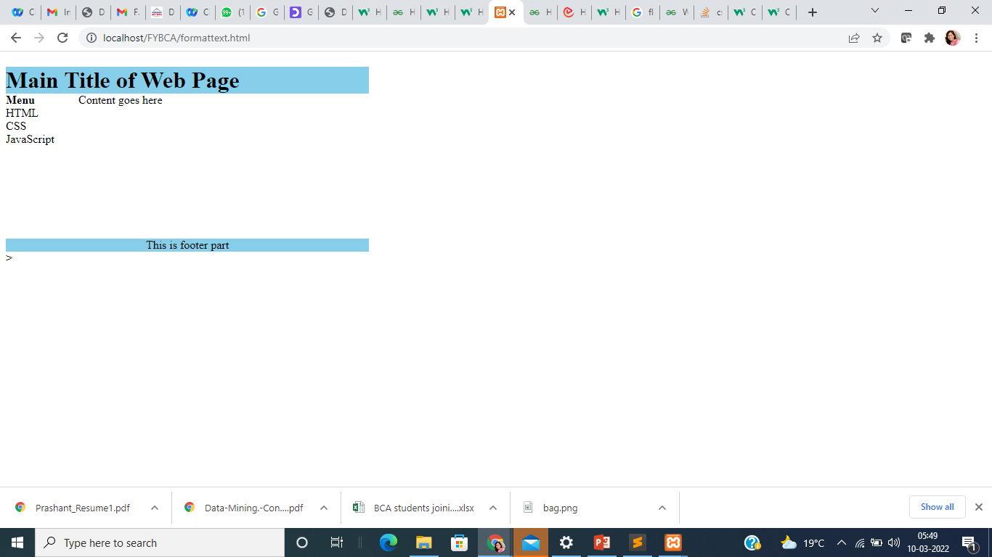
<html>
<body>
<div id="container" style="width:500px">
<div id="header" style="background-color:skyblue;">
<h1 style="margin-bottom:0;">Main Title of Web Page</h1></div>
<div id="menu" style="background-
color:green;height:200px;width:100px;float:left;">
<b>Menu</b><br>
HTML<br>
CSS<br>
JavaScript</div>
<div id="content" style="background-
color:#EEEEEE;height:200px;width:400px;float:left;">
Content goes here</div>
<div id="footer" style="background-color:skyblue;clear: left;text-align:center;">
This is footer part </div>
</div></body></html>>

Slide 17
Style Attribute
Example :
style="background-
color:sky value;height:200px;width:100px;float:left

Slide 18
Float property :
used to build layouts using div tag.
left | The element floats to the left of its container
right | The element floats the right of its container
<html>
<body>
<!doctype html>
<html>
<div class="outer-div">
This div tag
<div class="inner-div" style="float:right;" align="center">
contains this div tag.
</div>
</div>
</body>
</html

Slide 19
clear property :
CSS Clear property is used to stop next element to wrap around the adjacent floating elements. Clear can have clear left, clear right or clear both values.
CSS Clear Both property does not allow any element to wrap around any adjacent Floating element.
Clear Left can stop wrapping around left floating element
Clear right can stop wrapping around right floating element.
Div tag is the preferred element to use clear both as div is block level.

Slide 20
Lists in HTML
Lists are a great way to provide information in a structured and easy to read format.
Types of list in HTML
Ordered List
Unordered List
Description List

Slide 21
Ordered List (Numbered List) :an ordered list is used when sequence of list items is important.
Tag | Description | Attributes
<LI> | Specify the list item.
<OL> </OL> | The <OL> tag formats the contents of an ordered list with numbers. Then numbering starts at 1. It is incremented by one for each successive ordered list item tagged with <LI> | Type = a/A/i/I/ 1 Sets the numbering style to a,A,i, I,1 default 2. start = “A” Specifies the number or letter with which the list should start. This value is always an integer, even when the numbering type is letters or romans. E.g., to start counting list items from the letter "c" or the roman number "iii", use start="3".

Slide 22
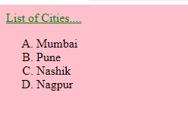
Ordered List (Numbered List) : Example
Example | Output
<body bgcolor= "pink"> <font face = "Arial” size= "6" color = "green"> <u> List of Cities.... </u> </font> <ol type = "A" start = "A"> <li> Mumbai <li> Pune <li> Nashik <li> Nagpur </ol> </body>

Slide 23
Unordered List (Bulleted List): An unordered list is a collection of related items that have no special order or sequence.
Tag | Description | Attributes
<LI> | Specify the list item.
<UL> </UL> | <UL> tag defines the unordered list of items | Type = disc/square/circle Specifies the bullet type.

Slide 24
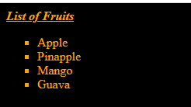
Unordered List (Bulleted List ): Example
Example | Output
<body bgcolor= "black" text =”yellow”> <font face = "Arial” size="6" color= "orange"> <i><u><b> List of Fruits </i></u></b> <ul type = "square"> <li> Apple <li> Pinapple <li> Mango <li> Guava </ul> </body> </html>

Slide 25
Description List : where entries are listed like in a dictionary
Tag | Description
<dl> | Defines the start of the list
<dt> | A term
<dd> | Term definition
</dl> | Defines the end of the list

Slide 26
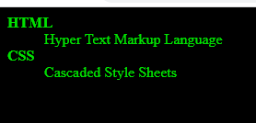
Description List : Example
Example | Output
<html> <head> <title>HTML Definition List</title> </head> <body bgcolor= "black" text =”yellow”> <dl> <dt><b>HTML</b></dt> <dd>Hyper Text Markup Language</dd> <dt><b>CSS</b></dt> <dd>Cascaded Style Sheets</dd> </dl> </body> </html>

Slide 27
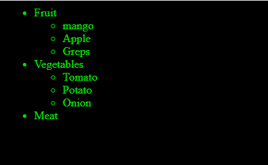
Nested List : A list can contain a new list
<html>
<head>
<title>HTML Definition List</title>
</head>
<body bgcolor= "black" text =”yellow”>
<ul>
<li>Fruit
<ul type="circle">
<li> mango
<li>Apple
</ul>
</li>
<li>Vegetables
<ul type="circle">
<li> Tomato
<li> Potato
<li> Onion
</ul>
</li>
<li>Meat</li>
</ul>

Slide 28
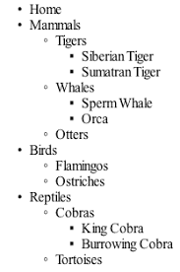

Write a HTML Code to generate Below List

Slide 29
Tables in HTML
A table is a two dimensional matrix, consisting of rows and columns.
HTML tables are intended for displaying data in columns on a web page.
Tables contains information such as text, images, forms, hyperlinks etc.

Slide 30
Tags to create tables in HTML
Tag | Attributes
<TABLE> </TABLE> | Border=number Draws an outline around the table rows and cells of width equal to number. By default table have no borders number =0. Width=number Defines width of the table. Cellspacing=number Sets the amount of cell space between table cells. Default value is 2 Cellpadding=number Sets the amount of cell space, in number of pixels between the cellborder and its contents. Default is 2 Bgcolor=”#rrggbb” sets background color of the table Bordercolor=”#rrggbb” sets border color of the table align=left|right|center Aligns the table. The default alignment is left frame=void|above|below|hsides|lhs|rhs|vsides|box|border Tells the browser which sides of a table frame should be displayed Rules = none/all/cols/groups/rows to specify the which parts of the inside borders that should be visible.

Slide 31
Tags to create tables in HTML
Tag | Attributes
<TR> </TR> Create a row | Align =right/left/center Bgcolor Valign=top/middle/bottom/baseline
<TH> </TH> | Colspan = “number” defines the number of columns a header cell should span. Rowsapn =“numer” Defines the number of rows a header cell should span
<TD> </TD> | Colspan = “number” defines the number of columns a header cell should span. Rowsapn =“numer” Defines the number of rows a header cell should span

Slide 32
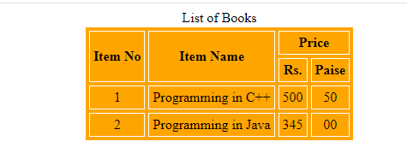

Slide 33
<html>
<head>
</head>
<body>
<table border = 2 cellspacing = 4 cellpadding = 4 bgcolor ="Orange" bordercolor ="white" align = "center">
<caption> List of Books </caption>
<tr>
<th rowspan = 2 align = "center"> Item No </th>
<th rowspan = 2 align = "center"> Item Name </th>
<th align = "center" colspan = 2> Price </th>
</tr>
<tr>
<th align = "center"> Rs. </th>
<th align = "center"> Paise </th>
</tr>
<tr>
<td align = "center"> 1 </td>
<td align = "center"> Programming in C++ </td>
<td align = "center"> 500 </td>
<td align = "center"> 50 </td>
</tr>
<tr>
<td align = "center"> 2 </td>
<td align = "center"> Programming in Java </td>
<td align = "center"> 345 </td>
<td align = "center"> 00 </td>
</tr>
</table>
</body>

Slide 34
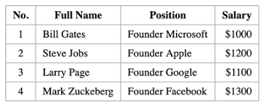
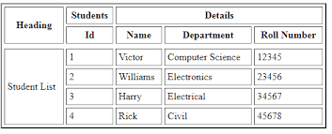

Slide 35
Frames in HTML
Using frames, one can divide the screen into multiple scrolling sections, each of which can display a different web page into it. It allows multiple HTML documents to be seen concurrently .

Slide 36
Tags used to add frames are given in the following table.
Tag | Description | Attributes
<FRAMESET> </FRAMESET> | Splits browser screen into frames. | Rows=number helps in dividing the browser screen into horizontal sections or frames. Cols=number divides the screen into vertical sections or frames. The number written in the rows and cols attribute can be given as absolute numbers or percentage value or an asterisk can be used to indicate the remaining space Bordercolor= text et the color differently for each frameset you have in your layout

Slide 37
Tags used to add frames are given in the following table.
Tag | Description | Attributes
<FRAME> </FRAME> | used to define a single frame in a | name=text Assigns a name to the frame src=url Specifies the location of the initial HTML file to be displayed by the frame. Frameborder=0 | 1 scrolling=auto|yes|no the scrollbar is used when the content is larger than the frame Element

Slide 38
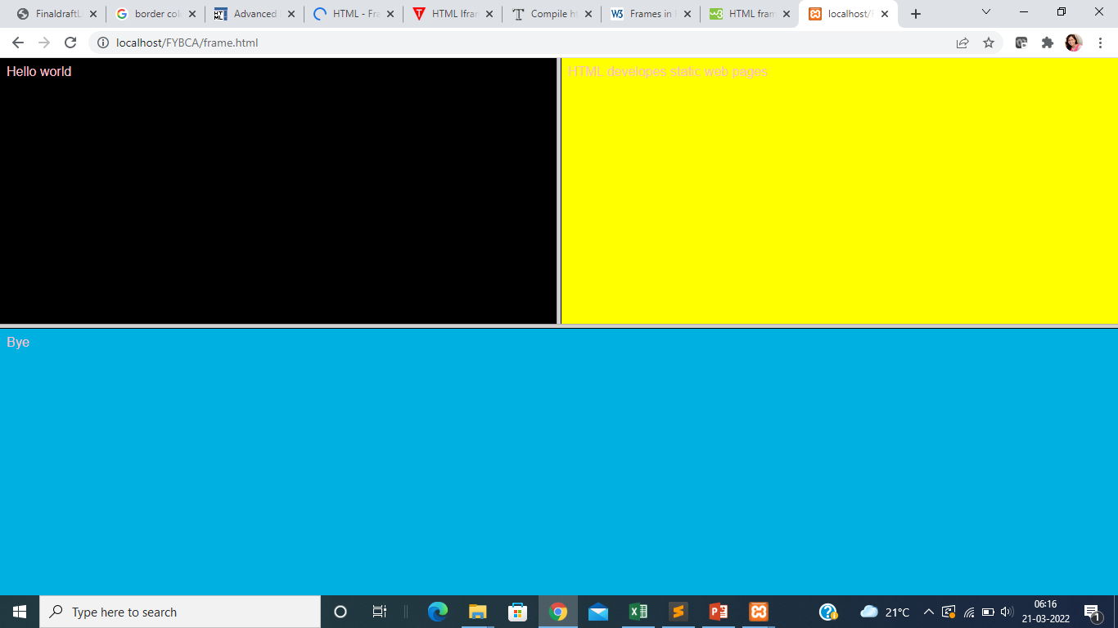
Frames in HTML
<html>
<frameset rows = "50%, *">
<frameset cols = "50%, *">
<frame src = "welcome.html"
name = "frm1">
<frame src = "intro.html">
</frameset>
<frame src = "bye.html">
</frameset>
</html>

Slide 39
iframe
Tag | Description | Attributes
<IFRAME> </IFRAME> | tag is used to specify an inline frame. An inline frame allows you to embed another document within the current HTML document | src="(URL of initial iframe content)" name="(name of frame, required for targeting)" width=(frame width, % or pixels) height=(frame height, % or pixels) align=[ top | middle | bottom | left | right | center ] frameborder=[ 1 | 0 ] scrolling=[ yes | no | auto ] (ability to scroll) marginwidth=(margin width, in pixels) omarginheight=(margin height, in pixels)

Slide 40
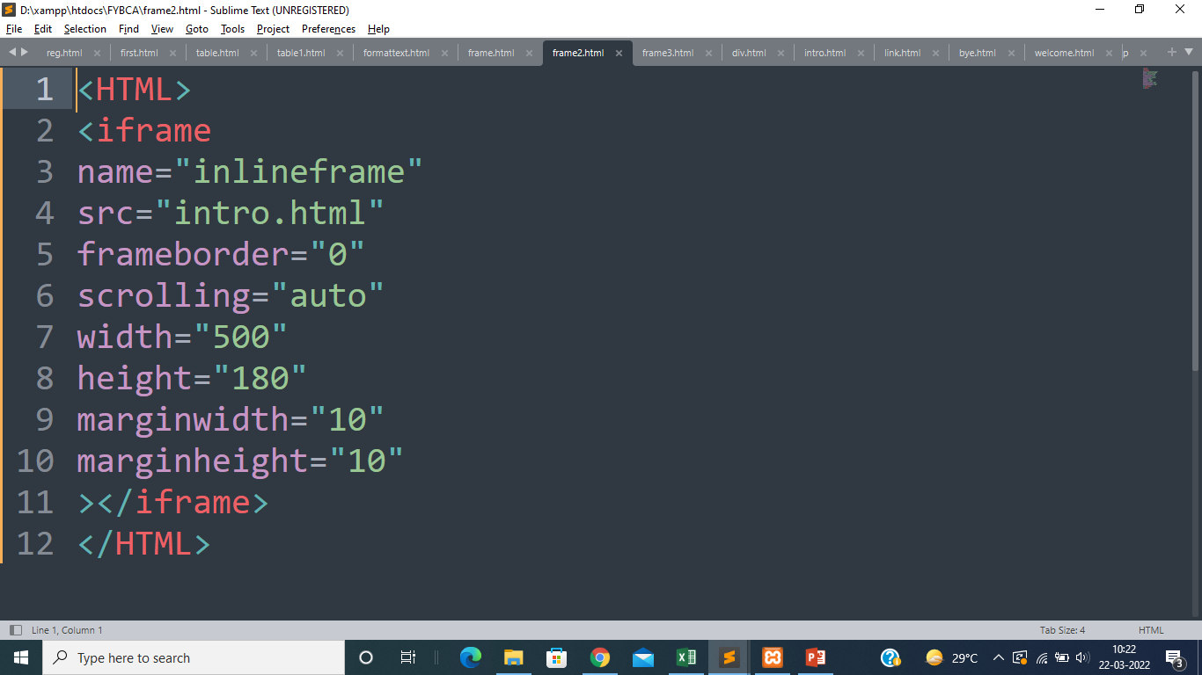
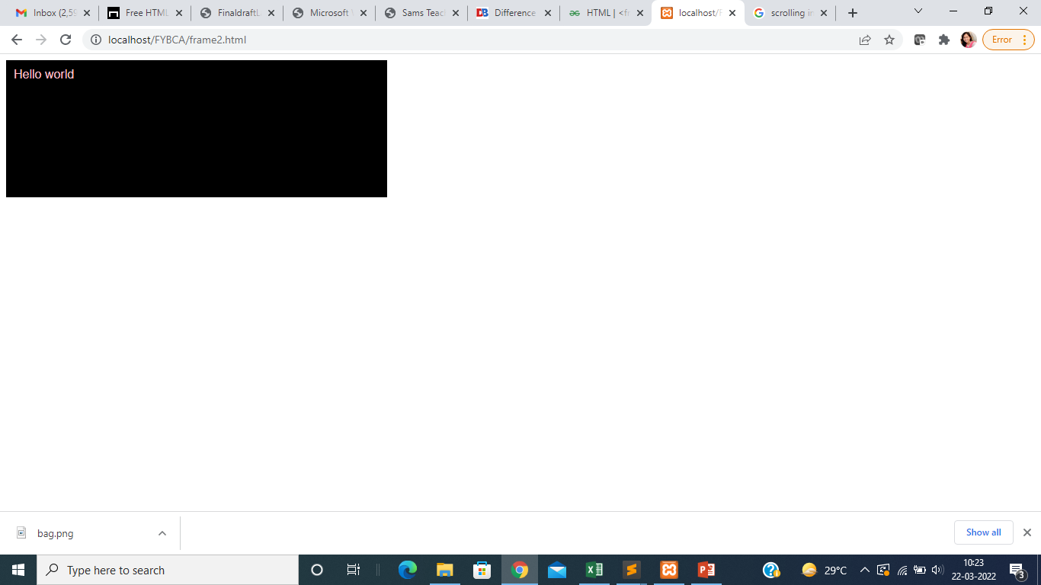

Slide 41
Hyperlink
Hyperlink is a specialized feature of HTML. Instead of clicking through sequentially organized pages, a hypertext user clicks specially highlighted text called ‘hyperlink’. Hyperlinks are technically known as anchors. They are usually visible in blue underlines..

Slide 42
Tags used to add frames are given in the following table.
Tag | Description | Attributes
<A> </A> | Add an anchor or hyperlink. | href=url Specifies the URL of the target page.

Slide 43
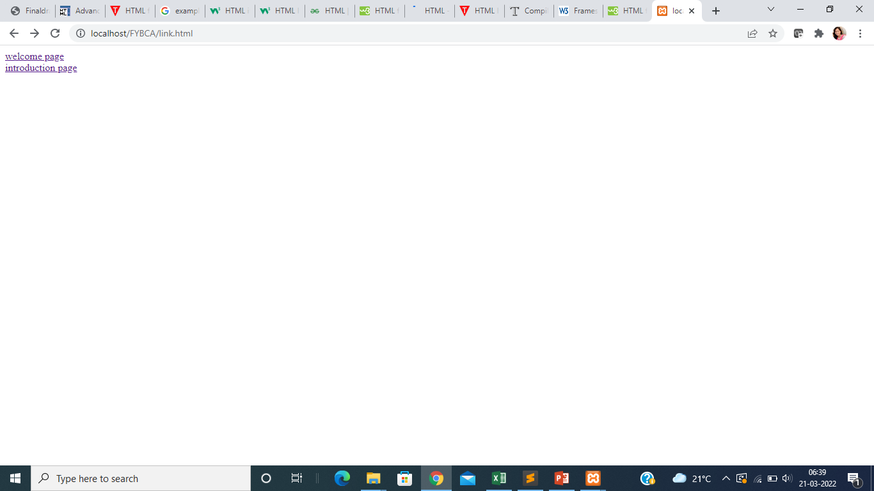
Hyperlink
<BODY>
<a href="welcome.html"> welcome page</a> <br>
<a href="intro.html"> introduction page</a>
</BODY>

Slide 44
<a href="intro.html"> introduction page</a>

Slide 45
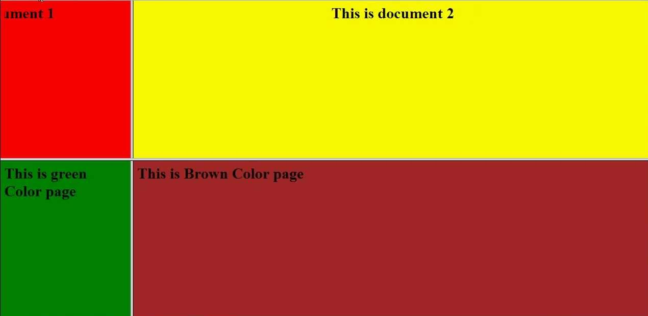

Slide 46
Forms in HTML
HTML5 provides better & more extensive support for collecting user inputs through forms.
A form can be placed anywhere inside the body of an HTML document.
You can have more than one form in the document.

Slide 47
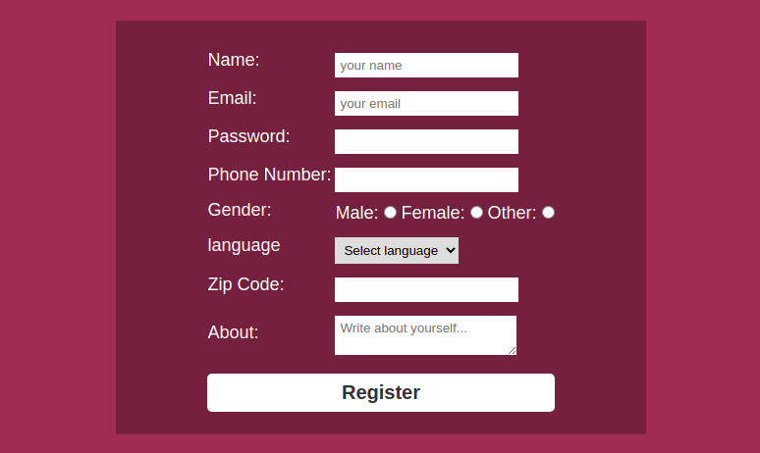
Sample form

Slide 48
Tags used to add input forms are given in the following table.
Tag | Attributes | Attributes
<FORM> </FORM> Creates a form | action="URL" Gives the URL of the application that is to receive & process the forms data. method="get" or "post" Sets the method by which the browser sends the forms data to the server for processing. | <!doctype html> <head>.. </head> <body> <form action=”url” method=”post/get”> </form> </body> </html>

Slide 49
Tag | Attributes | Attributes
<INPUT> </INPUT> It is used for managing theinput controls that will be placed within the tag. | Name=text It is used to name the field. Maxlength=number The maximum number of input characters allowed in the input control. Size=number The width of the input control in pixels. Type=type of input value= value to be submitted with the form (for a checkbox or radio button); or label (for Reset or Submit buttons)" src="source file for an image",\ checked indicates that checkbox | <!doctype html> <head>.. </head> <body> <form action=”url” method=”post/get”> </form> </body> </html>

Slide 50
Input types supported in HTML
text | Defines a one-line text input field
password | Defines a one-line password input field
submit | Defines a submit button to submit the form to server
reset | Defines a reset button to reset all values in the form.
radio | Defines a radio button which allows select one option.
checkbox | Defines checkboxes which allow select multiple options form.
button | Defines a simple push button, which can be programmed to perform a task on an event.
file | Defines to select the file from device storage.
image | Defines a graphical submit button.

Slide 51
Tag | Attributes | Attributes
<SELECT> </SELECT> Defines and displays a set of optional list items from which the user can select one or more items. | name=" (name to be passed to the script as part of name/value pair)“ value= value to be submitted as part of select | <select name="city" value="city"> <option value="pune">Pune</option> <option value="Mumbai">Mumbai</option> <option value="Nagpur">Nagpur</option> <option value="Nashik">Nashik</option> </select>
<TEXTAREA> </TEXTAREA> multiline text entry widget | name=name of data field rows= Columns= | <textarea rows=10 columns=40> </textarea>
<OPTION> </OPTION> indicates a possible item within aselect widget | selected=default selection value="data submitted if this option is selected" | <select name="city" value="city"> <option value="pune">Pune</option> <option value="Mumbai">Mumbai</option> <option value="Nagpur">Nagpur</option> <option value="Nashik">Nashik</option> </select>

Slide 52
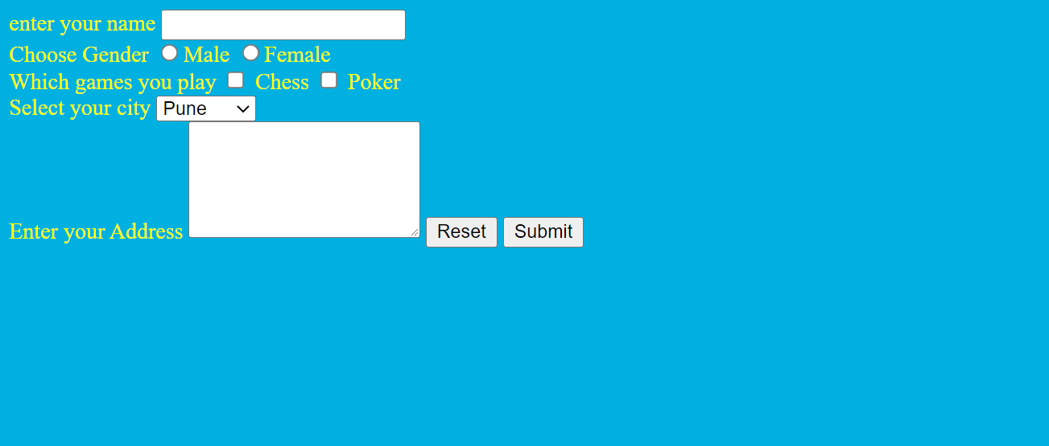

Slide 53
Input Types | Use | Example
Label | Define a label for element | <form> <label for> enter your name</label> <input type=”text”></form>
Legend | Define a caption for fieldset element | <form> <fieldset> <legend>create new account</legend> <fieldset> </form>
Number | for numerical input | <input type="number" min="0" max="20" step="2" value="10" name="some-name"/>
Date | For entering a date with no time zone. | <input type="date" name="some-name"/>

Slide 54
Input Types | Use | Example
Time | For entering a time value with hour, minute, seconds, and fractional seconds, but no time zone. | <input type="time"/>
Datetime-local | For entering a date and time with no time zone. | <input type="datetimelocal"/>
Color | For choosing color through a color well control | <input type=“color"/>
Email | For entering either a single email address or a list of email addresses. | <input type="email" name="some-name" value="firstname@gmail.com"/>

Slide 55
Input Types | Use | Example
URL | For entering a single URL. | <input type="url" name="some-name"/>
Placeholder | Gives the user a hint about what sort of data they should enter. | <input type=text placeholder="Firstname Lastname"/>
autofocus | Focuses the input on the element when the page is loaded. | <input id=" last name" type="text" autofocus="true" >

Slide 56
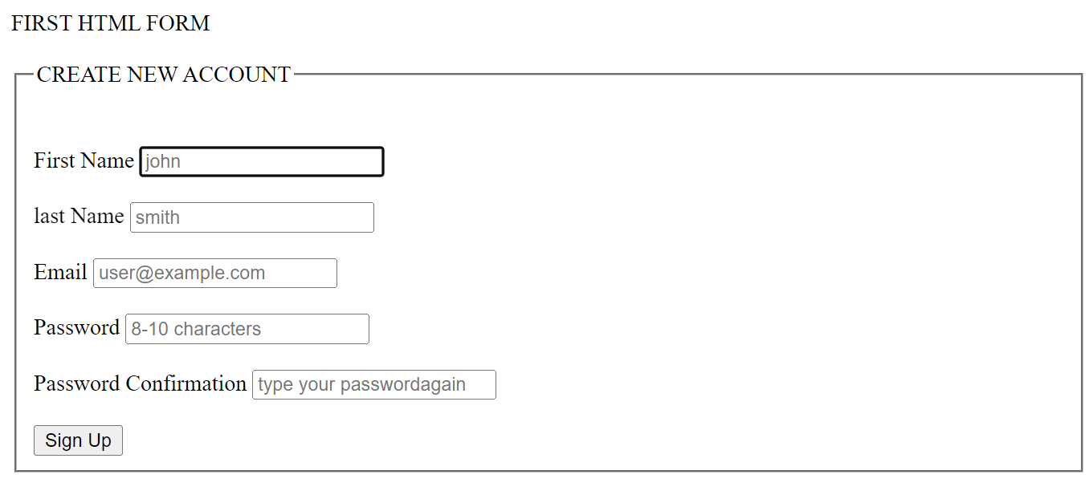

Slide 57
introduction to HTML5
HTML5 is the new version of the HTML
you can create web applications that work offline, support high-definition video and animations
Making code easier to read for users and screen readers
Reducing the overlap between HTML, CSS, and JavaScript
Promoting design responsiveness and consistency across browsers
Supporting multimedia without the need for Flash or other plugins
In addition to all the standard form input types, HTML5 offers more, including: datetime, datetime-local, date, month, week, time, number, range, email, and url etc

Slide 58
Why HTML5
It’s compatible across browsers.
It enables offline browsing : Browsers that support HTML5 offline applications (which is most) will download the HTML, CSS, JavaScript, images, and other resources that make up the application and cache them locally. Then, when the user tries to access the web application without a network connection, the browser will render the local copies. That means you won’t have to worry about your site not loading if the user loses or doesn’t have an active internet connection.
It allows you to write cleaner code :HTML5 allows you to write more semantically meaningful code, which enables you and other readers to separate style and content(without div tags)

Slide 59
HTML Audio,video Tag
HTML audio tag is used to define sounds such as music and other audio clips
we can embed audio files using the <audio> tag
We can embed video files using <video> tag

Slide 60
Tags used to add audio
Tag | Attributes | Examples
<audio> </audio> | Controls : It defines the audio controls which is displayed with play/pause buttons. Loop :It specifies that the audio file will start over again, every time when it is completed.
<source> </source> | src: file path Type : type of file | <!DOCTYPE html> <html> <body> <audio controls loop> <source src="jingle-bells-11295.mp3" type="audio/mp3"> </audio> <p>Click the play button</p> </body> </html>

Slide 61
Tags used to add video
Tag | Attributes | Examples
<video> </video> | Controls : It defines the audio controls which is displayed with play/pause buttons. Loop :It specifies that the audio file will start over again, every time when it is completed.
<source> </source> | src: file path Type : type of file | <!DOCTYPE> <html> <body> <video width="250" height="250" controls loop> <source src="waterfall.mp4" type="video/mp4"> Your browser does not support the html video tag. </video> </body> </html>

Slide 62
HTML Canvas Tag
It defines an area on the web page, where we can create different objects, images, animations, photo compositions via scripts (usually JavaScript).
You should use a script to draw graphics because the <canvas> tag is just a container for graphics.

Slide 63
Tags used to add video
Tag | Attributes | Examples
<canvas> </canvas> | Id: identifier Height :Specifies the height of the canvas. Width :Specifies the width of the canvas | <!DOCTYPE html> <html> <head> <title>Title of the document</title> </head> <body> <canvas id="canvas1">Your browser doesn’t support the HTML5 canvas element.</canvas> <script> var c=document.getElementById('canvas1'); var ctx=c.getContext('2d'); ctx.fillStyle='black'; ctx.fillRect(10,50,80,80); </script> </body> </html>

